Slide 1
Autonomous Ground Support Equipment Design, Construction & Implementation NASA Student Launch Initiative 2014-2015
Pranav Srinivas Kumar & William Emfinger
Vanderbilt Aerospace Club
The 2014-15 Aerospace Club was sponsored by the Department of Mechanical Engineering and the Boeing Corporation.

Slide 2
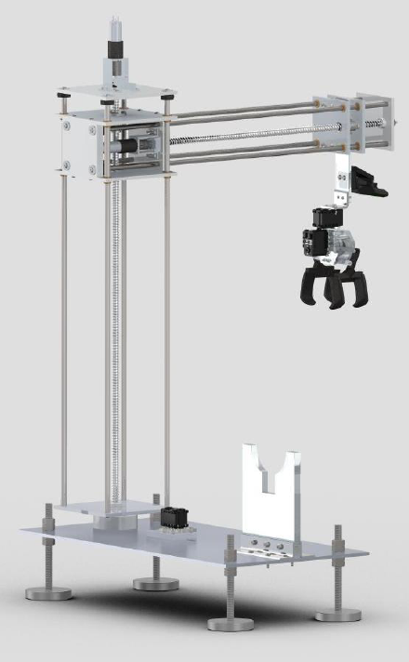
Overview
Autonomous Ground Support
Sample Retrieval
Design Goals
Reliability
Simplicity
Robustness
Design Considerations
Minimum degrees of freedom
Image Processing
Distributed Embedded System
User Input Panel
Model-driven software
development

Slide 3
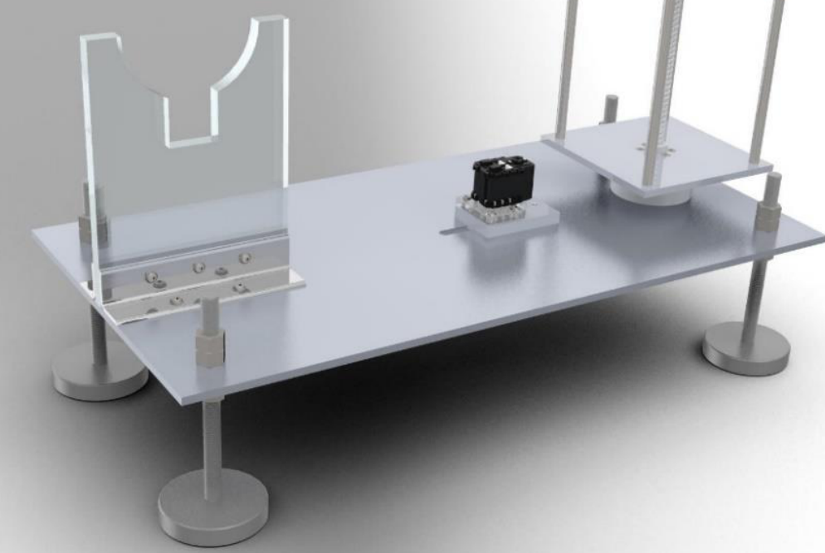
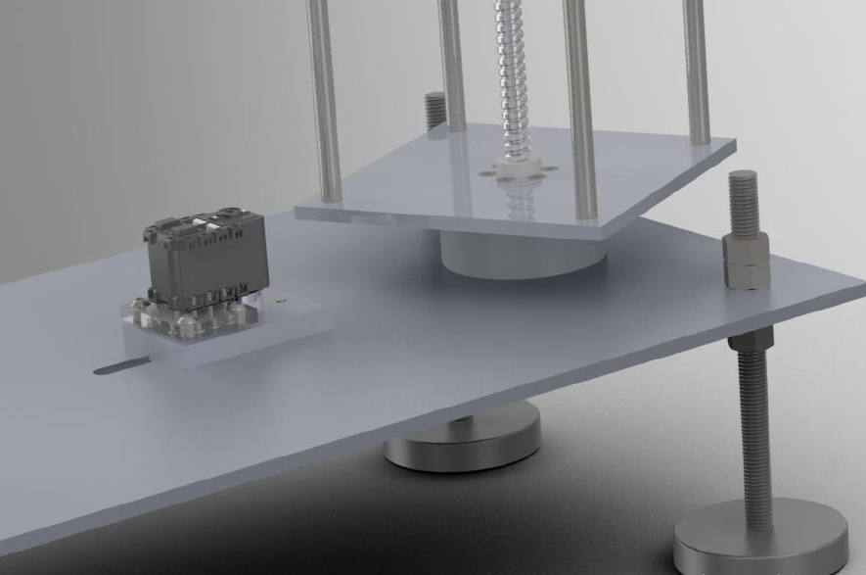
Mechanical Construction (1/3)
AGSE Base Table
25.5” tall and up to 19.5” radial reach
Adjustable leveling feet
Rocket stand and Base rotation system

Slide 4
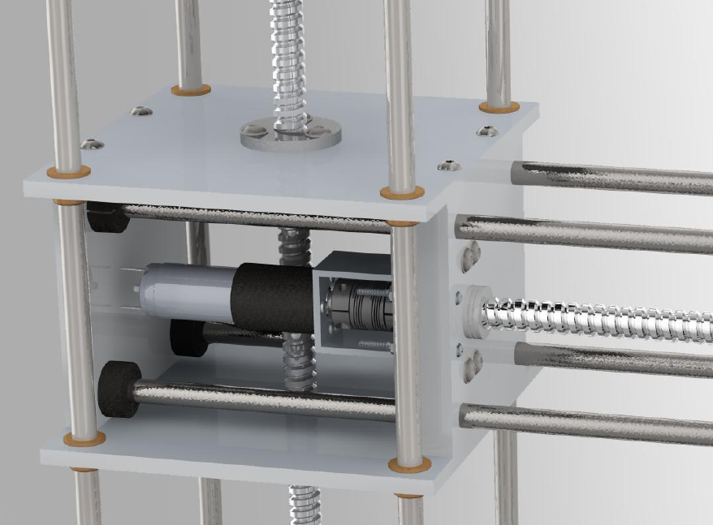
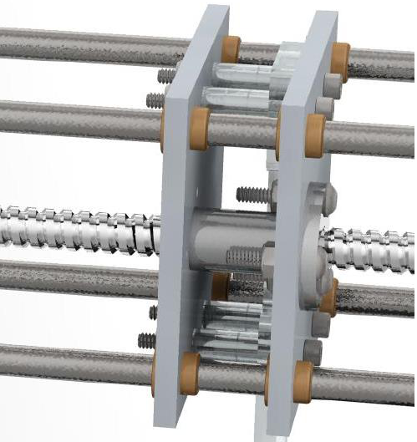
Mechanical Construction (2/3)
Lead Screw Linear Actuation
Faulhaber 12V, 8.1W motors
Vertical carriage supports a horizontal powertrain

Slide 5
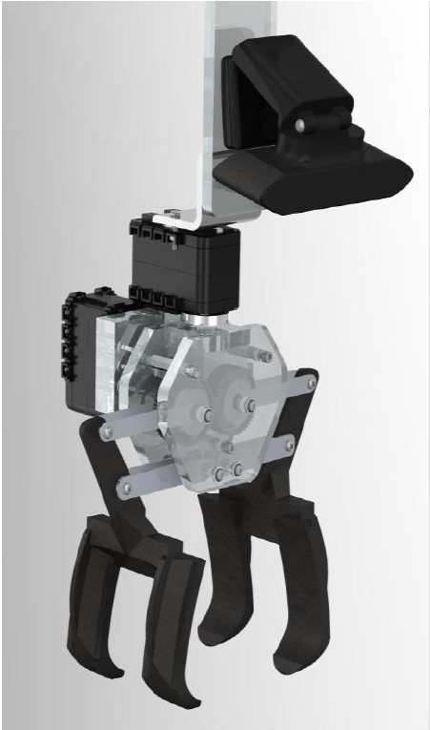
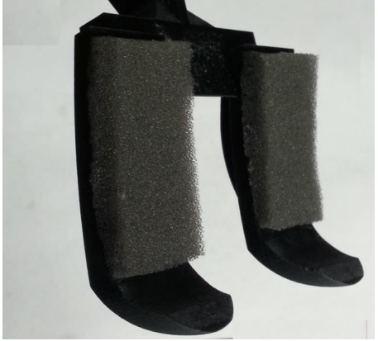
Mechanical Construction (3/3)
AGSE Gripper
Optimized phalange curvature
Acrylic “gear box”

Slide 6
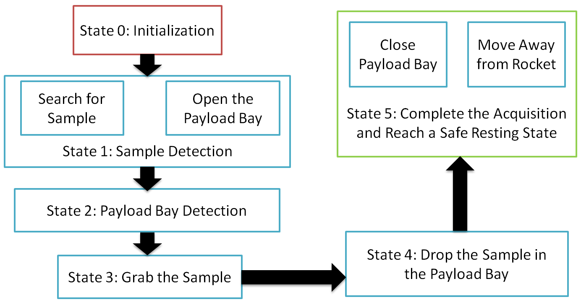
AGSE Overview

Slide 7
AGSE Electronics (1/3)
Custom PCB
Attaches to the BeagleBone Black as a cape
Provides power & functionality for
Serial buffer for UART
3.3V to 5V for servo control
H-Bridge for Vertical Actuation Motor
H-Bridge for Radial Actuation Motor
Radial axis quadrature encoder
Vertical axis quadrature encoder

Slide 8
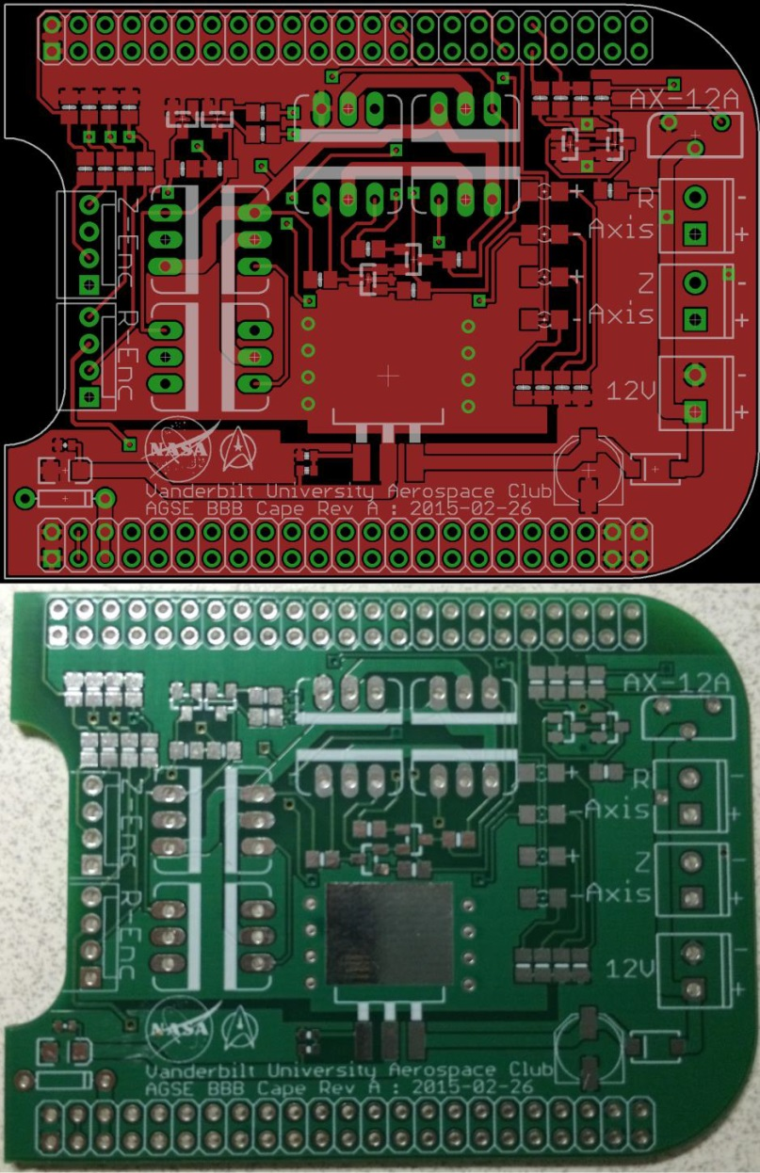
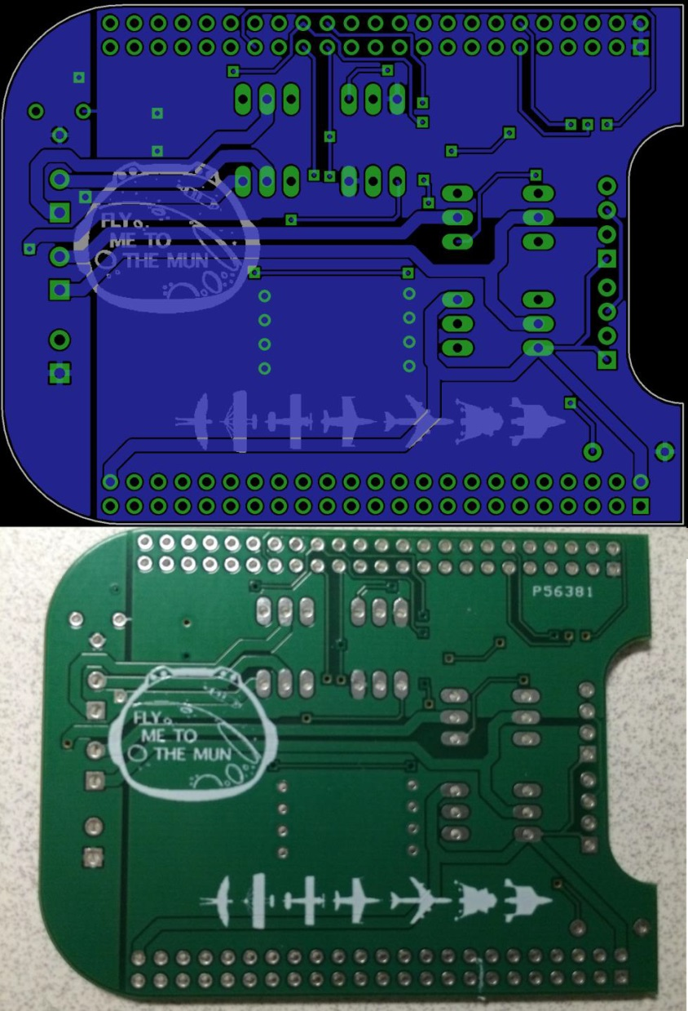
AGSE Electronics (2/3)

Slide 9
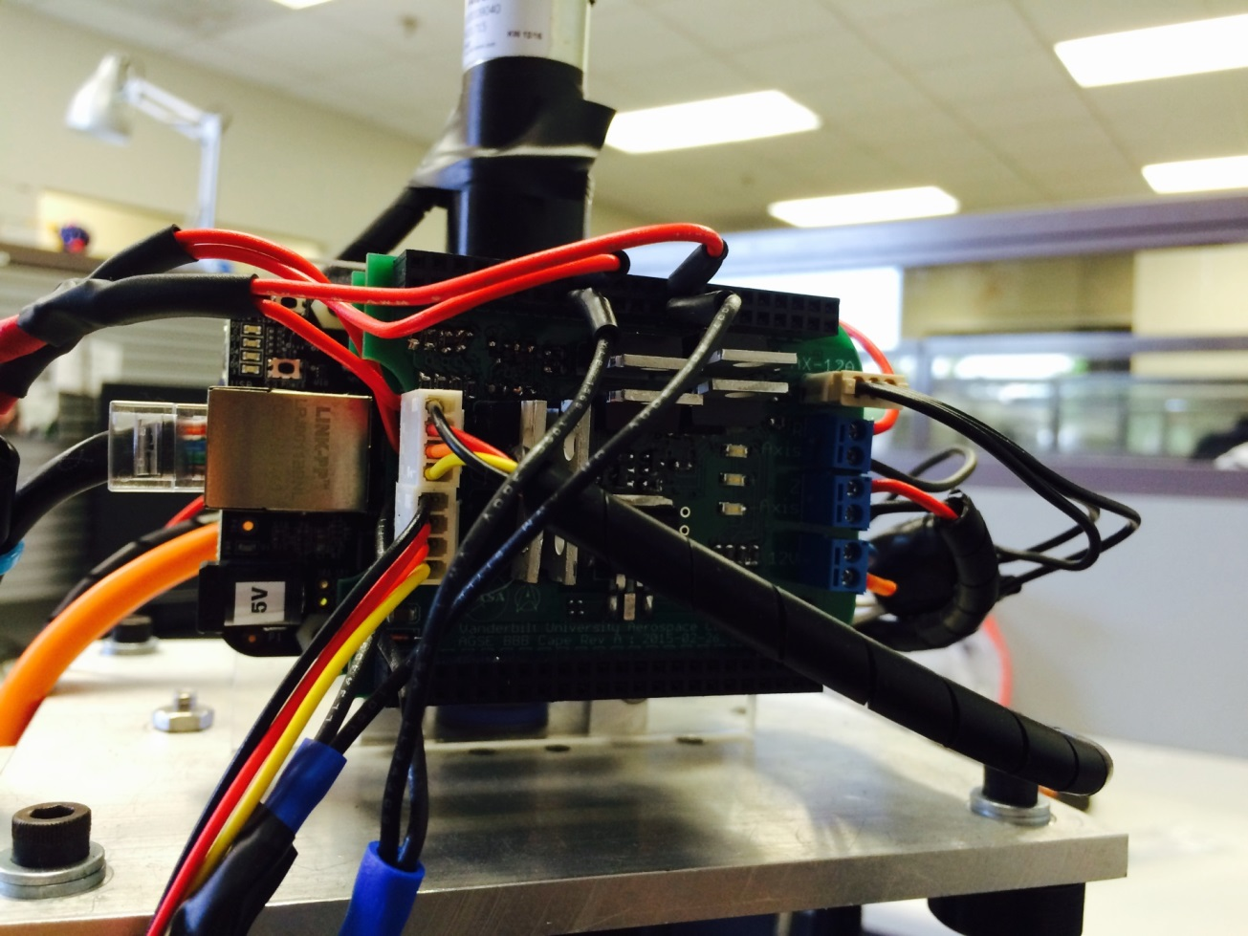
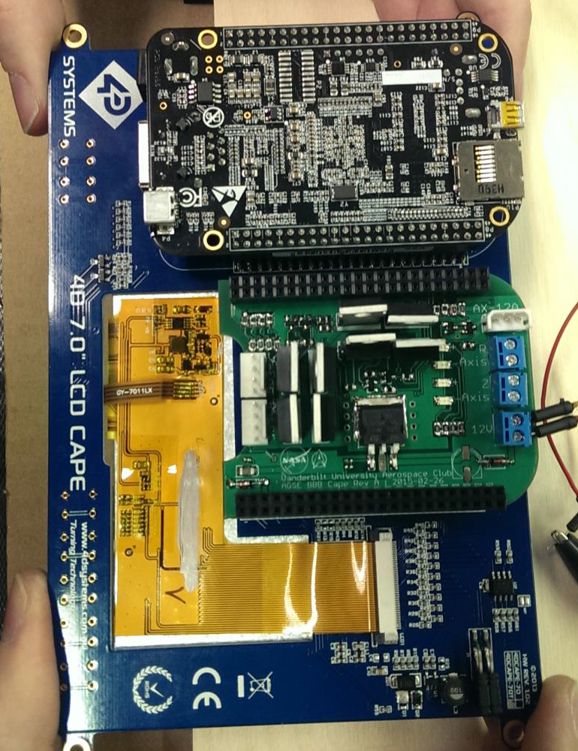
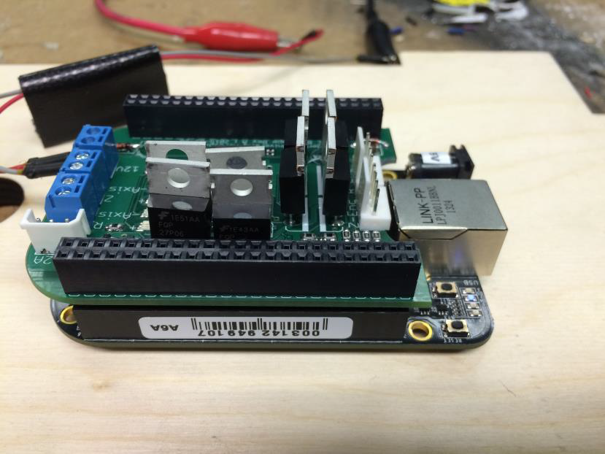
AGSE Electronics (3/3)

Slide 10
Image Processing – Sample Detection
OpenCV software library
Computer vision to classify and track observed objects in real-time
Periodic Processing
Convert RGB image frame to HSV/Grayscale image frame
Apply thresholding, filtering, erosion and dilation procedures
Draw contours around detected objects
Calculate position & relative orientation

Slide 11
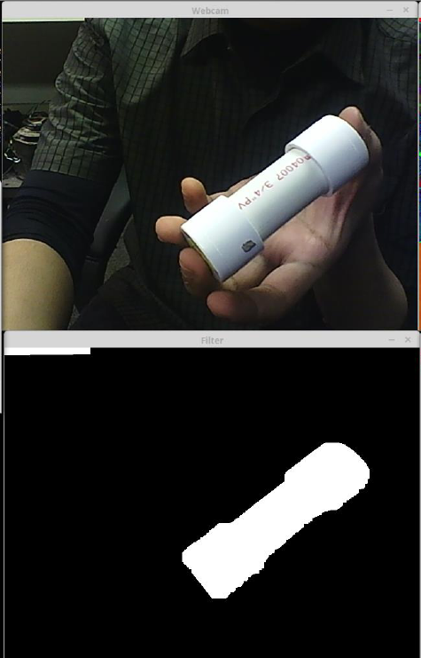
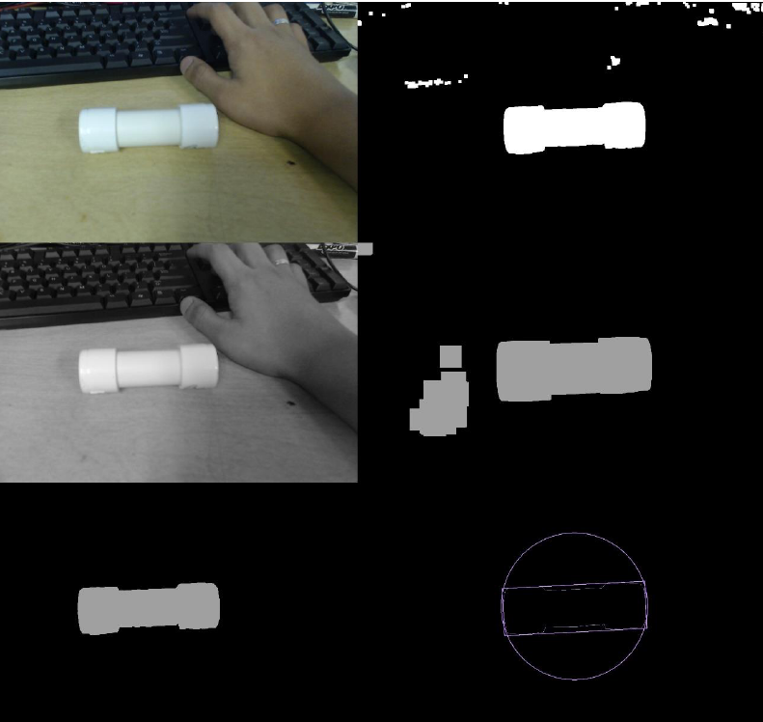
Real-time Object Tracking
Webcam
HSV Filter
Grayscale
Thresholding Filter
Bitwise-AND Result
Bounding Box

Slide 12
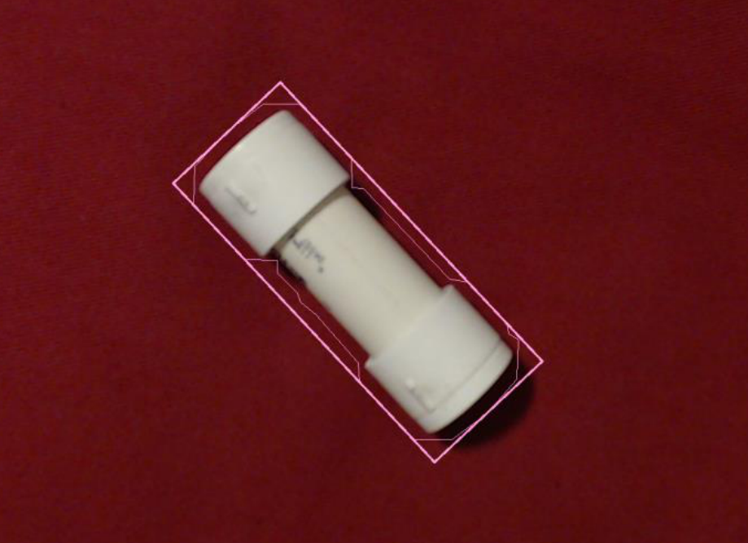
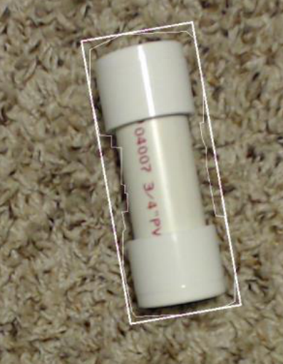
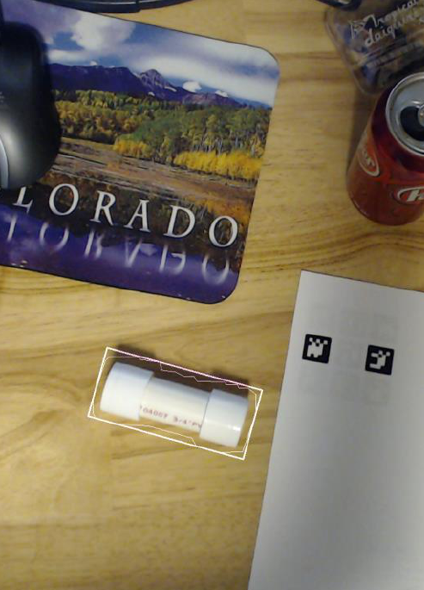
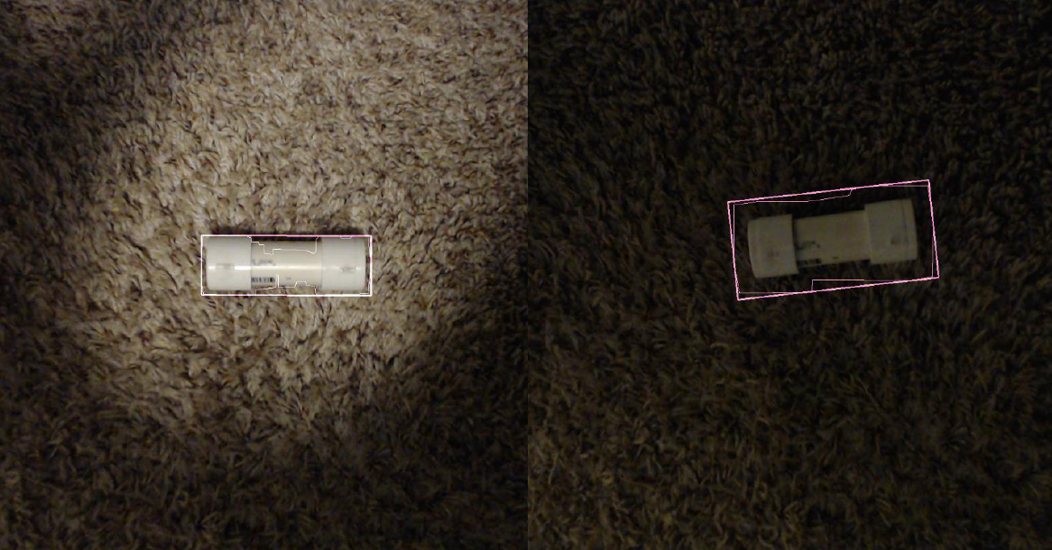
Feature-based Filtering Heuristics

Slide 13
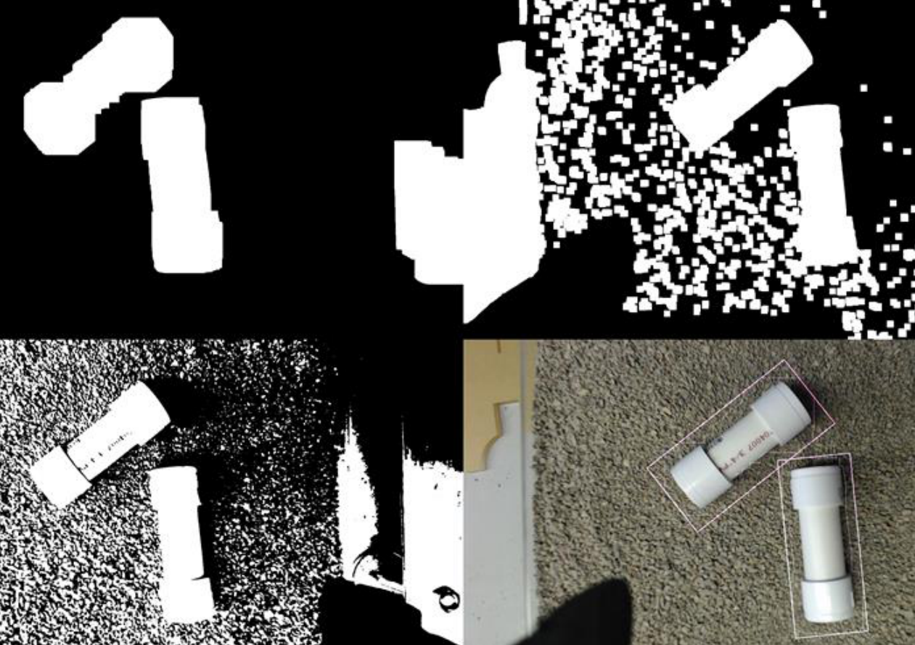
Multiple Sample Detection

Slide 14
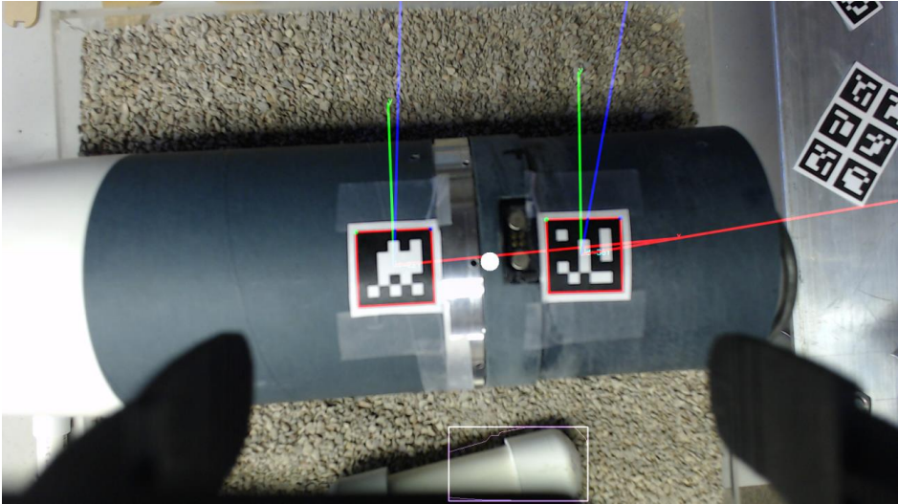
Payload Bay Detection

Slide 15
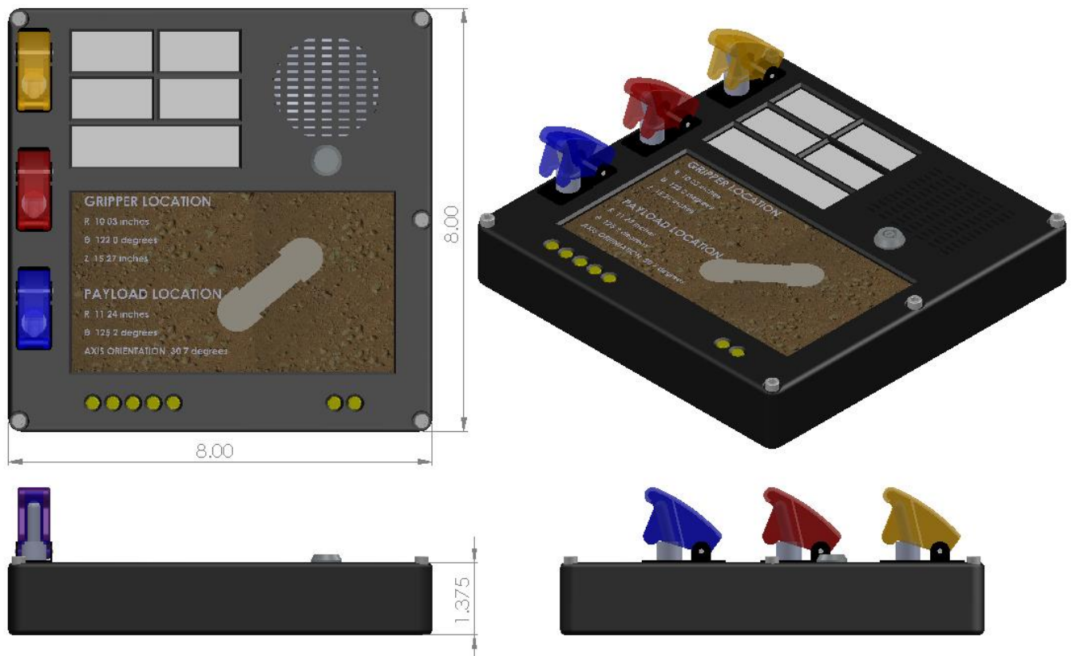
User Input Panel

Slide 16
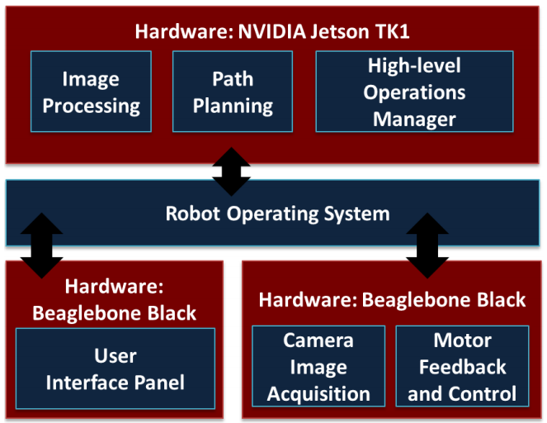
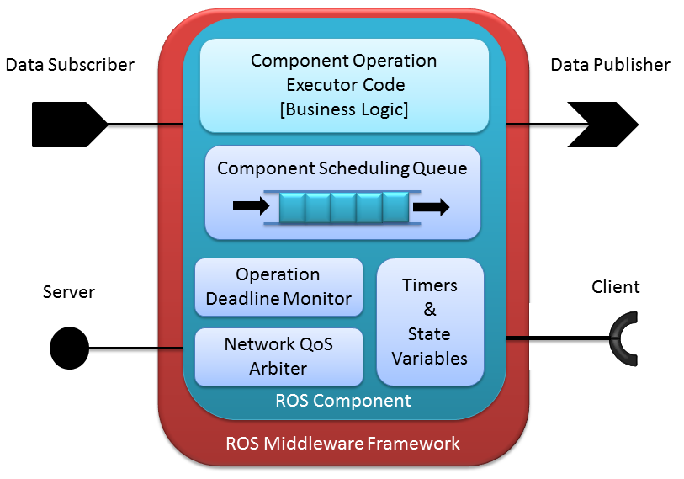
Software Development Robot Operating System & ROSMOD
Distributed Embedded System
Use Robot Operating System
ROSMOD Component Model
Modeling, Code Generation & Deployment tool suite

Slide 17
ROSMOD Projects
Software Workspace Model
Messages, Services & Component definitions
Workspace & build system generation
Hardware Model
IP Address, Architecture & network topology
Deployment Model
Process-to-Hardware mapping
Component Instantiation in processes
Deployment-specific XML Generation

Slide 18
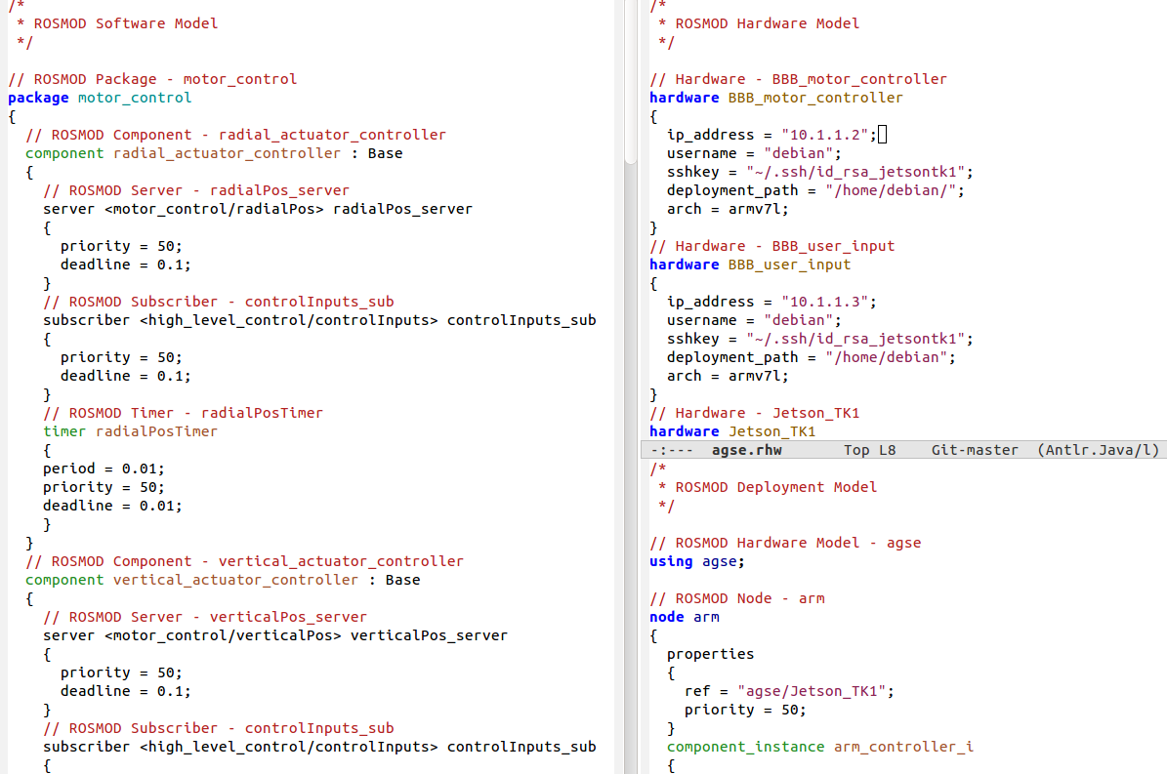
Textual Language

Slide 19
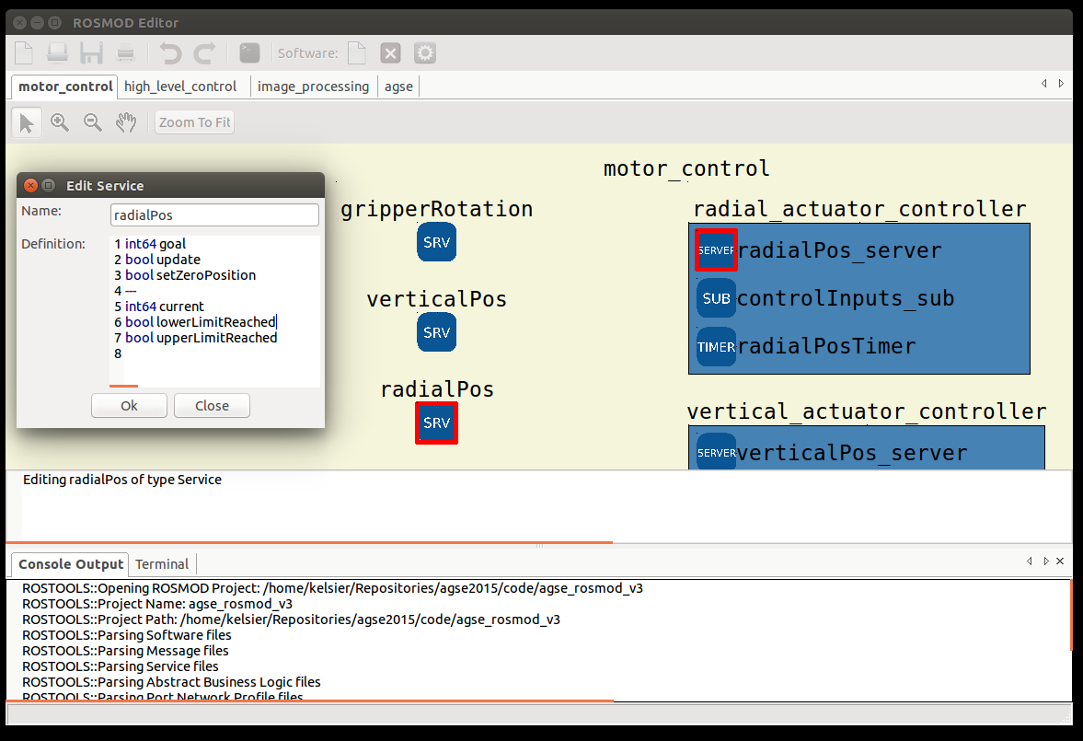
ROSMOD Editor – Software Model

Slide 20
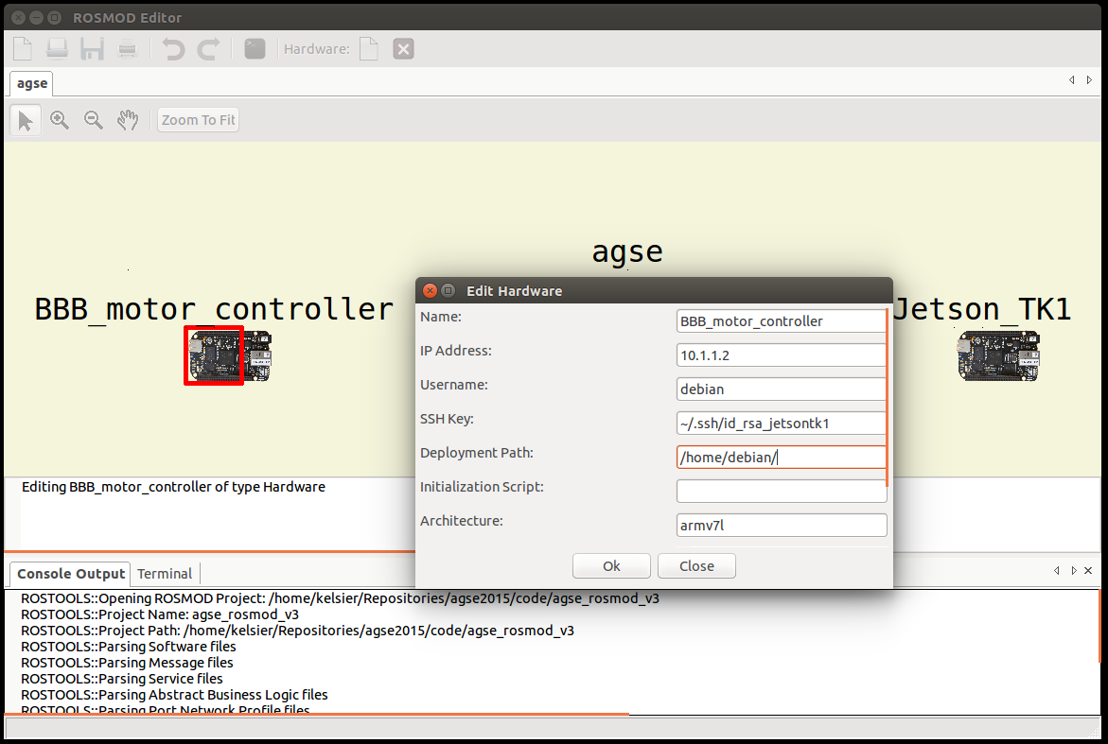
ROSMOD Editor – Hardware Model

Slide 21
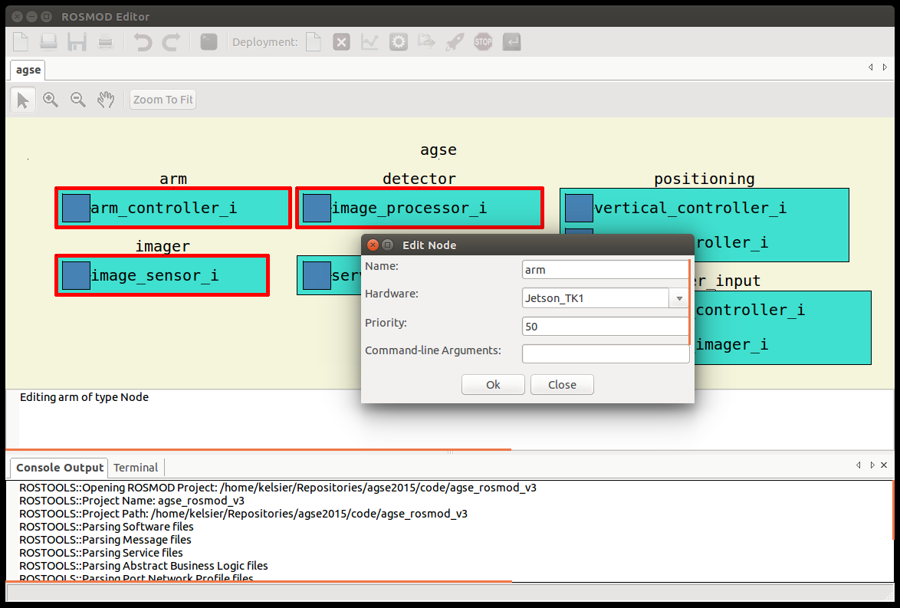
ROSMOD Editor – Deployment Model

Slide 22
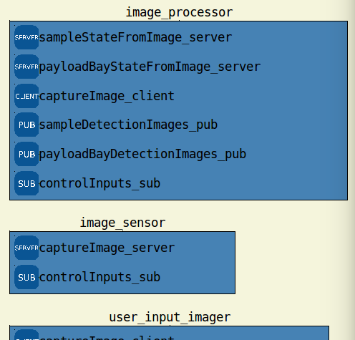
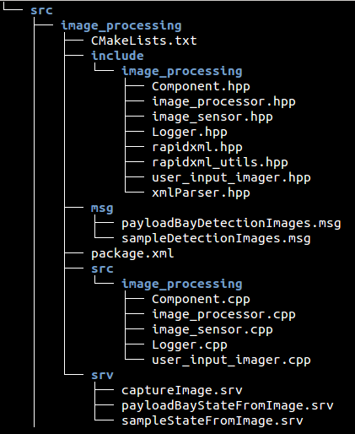
Workspace Code Generation

Slide 23
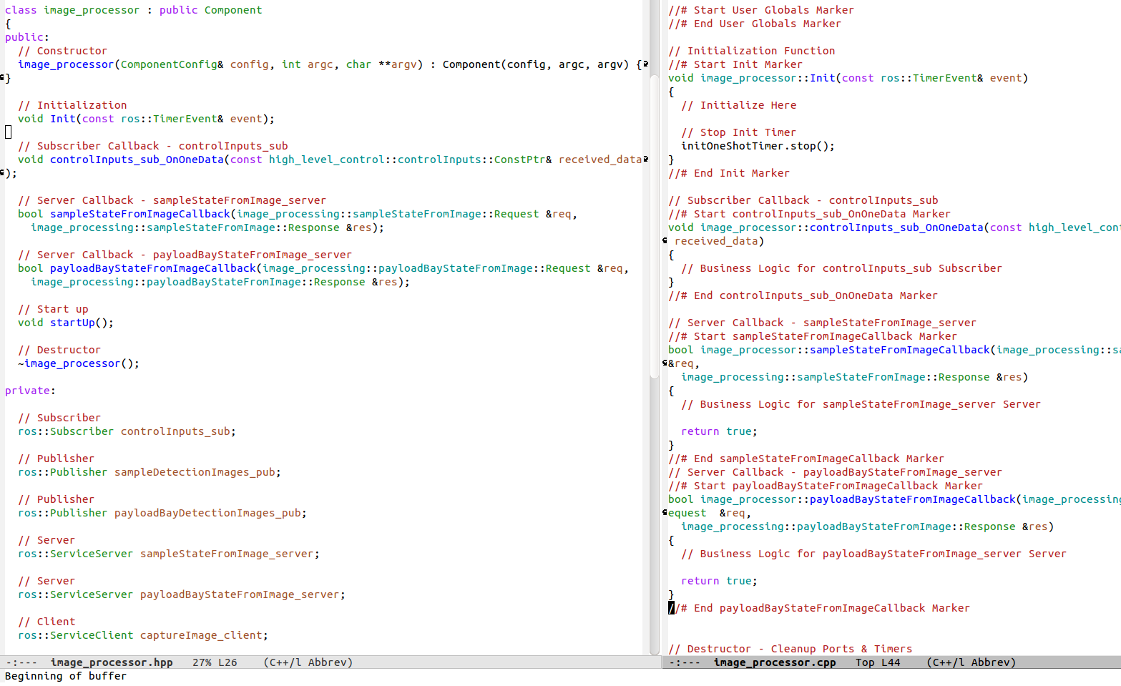
Generated Skeleton Code

Slide 24
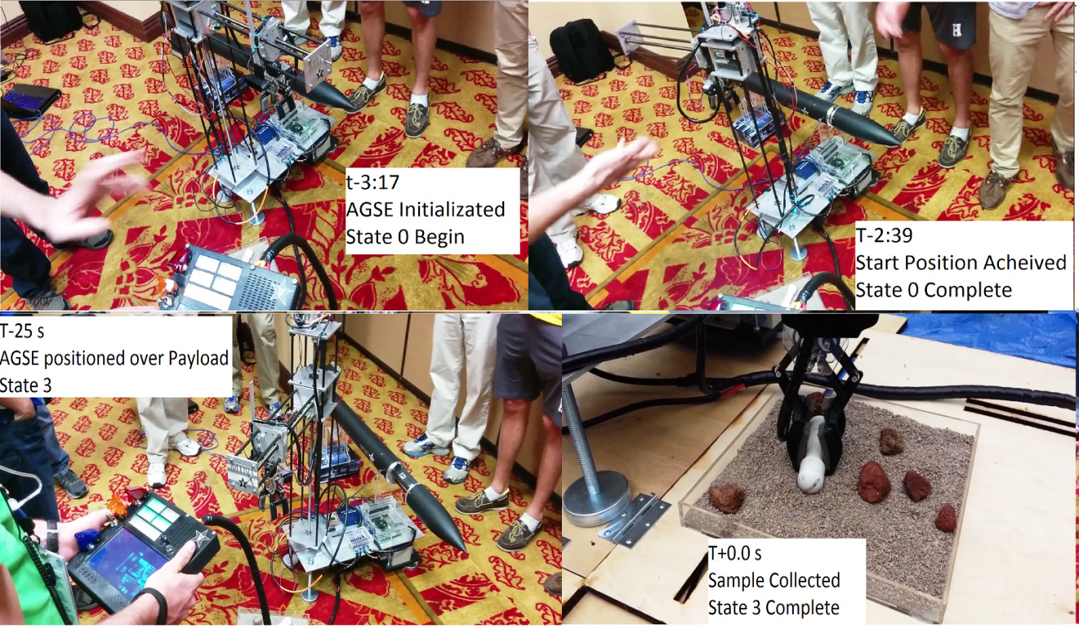
Performance Assessment

Slide 25
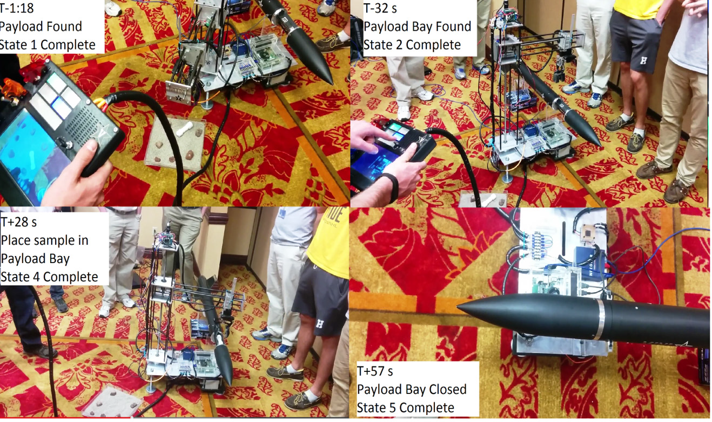
Performance Assessment

Slide 26
Summary
Model-driven Component-based Engineering
Distributed Managed Embedded System
Robot Operating System & ROSMOD
Autonomous Sample Retrieval
Periodic Image Processing
Unknown Sample & Rocket location
Under 5 minutes on Competition Day
We won ☺

Slide 27
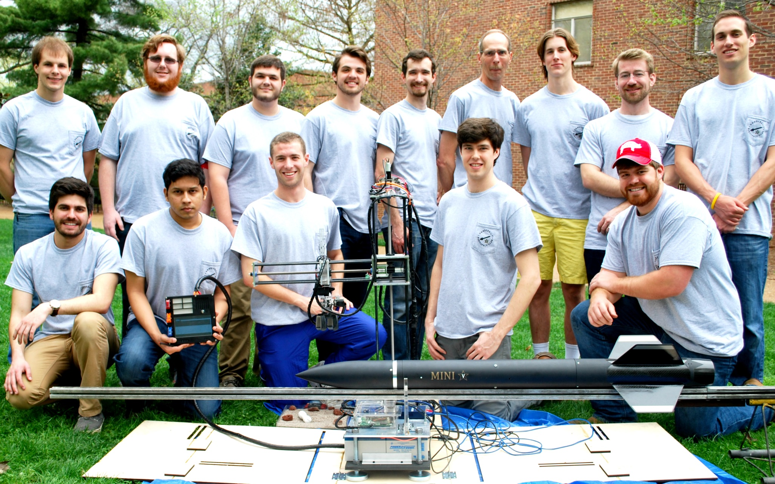
Vanderbilt Aerospace Club 2014-2015

